Slide 1
Frameworks

Slide 2
Frameworks
The term “web framework” can mean many things, it depends upon who you ask.
Agreement, a framework should make your job easier by providing code and structure.

Slide 3
What does “framework” mean here?
Front-end developers
CSS, JavaScript, jQuery
Back-end developers
Routing, resources, security

Slide 4
Popular front-end frameworks
Bootstrap (2011)
Its popularity makes it…. popular
Foundation by ZURB (2011)
Semantic UI (2013)
Pure by Yahoo! (2013)
Ulkit by YOOtheme(2013)
sitepoint.com

Slide 5
What it means for you
Many people build their sites directly from templates.
Others use their own code and add functionality.
Even “pure” coders should know the basics of one popular framework

Slide 6
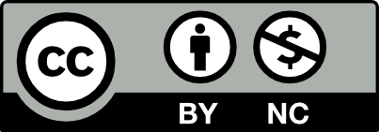
Acknowledgements/Contributions
These slides are Copyright 2016- Colleen van Lent as part of http://www.intro-webdesign.com/ and made available under a Creative Commons Attribution NoncCommercial 4.0 License. Please maintain this last slide in all copies of the document to comply with the attribution requirements of the license. If you make a change, feel free to add your name and organization to the list of contributors on this page as you republish the materials.
Initial Development: Colleen van Lent , University of Michigan School of Information

